Slide 1


Optimizing to make better conservation decisions
Jeffrey Hanson and Richard Schuster
jeffrey.hanson@uqconnect.edu.au
richard.schuster@natureconservancy.ca

Slide 2
Now
Biodiversity
Status quo
2000
Future

Slide 3
Now
How do we
get here?
Biodiversity
Status quo
2000
Future

Slide 4



Observations
Statistical models
Priority areas
Biodiversity
2000
Future
Data
Information
Plan
Outcome
Objectives
Constraints

Slide 5
Observations
Statistical models
Priority areas
Biodiversity
2000
Future
Data
Information
Plan
Outcome
Better
plan
Better
outcome
Objectives
Constraints

Slide 6
Reserve selection
Planning units
Discrete places for conservation management
Each planning unit is managed separately
Commonly include land parcels, islands, spatial grid cells
Notes:
- not all remaining habitat can be preserved
- achieve conservation objectives for minimal cost
- modern systematic conservation planning primarily focusses on representing species
- however, this ignores intra-specific biodiversity

Slide 7





Reserve selection
Features
Stuff that we care about
Each feature is relatively independent
Commonly include species, ecosystem types, ecosystem services (e.g., water provisioning, carbon sequestration)
Notes:
- not all remaining habitat can be preserved
- achieve conservation objectives for minimal cost
- modern systematic conservation planning primarily focusses on representing species
- however, this ignores intra-specific biodiversity

Slide 8
Reserve selection
Which planning units should we manage for conservation?
Notes:
- not all remaining habitat can be preserved
- achieve conservation objectives for minimal cost
- modern systematic conservation planning primarily focusses on representing species
- however, this ignores intra-specific biodiversity

Slide 9
CARE-C Principles
Comprehensive
Adequate
Representative
Efficient
Connectivity
Nielsen et al. (2023) Trends Ecol Evol, doi:10.1016/j.tree.2022.09.006

Slide 10


CARE-C Principles
Comprehensive
Adequate
Representative
Efficient
Connectivity
versus

Slide 11
CARE Principles
Comprehensive
Adequate
Representative
Efficient
Connectivity
versus

Slide 12


CARE-C Principles
Comprehensive
Adequate
Representative
Efficient
Connectivity
versus

Slide 13
CARE-C Principles
Comprehensive
Adequate
Representative
Efficient
Connectivity
versus

Slide 14
CARE-C Principles
Comprehensive
Adequate
Representative
Efficient
Connectivity
versus

Slide 15
Principle complementarity
Protected areas should “complement” each other to maximize the performance of the overall protected area network (including. existing protected areas)
Vane-Wright, et al (1991) Biol Cons, DOI: 10.1016/0006-3207(91)90030-D

Slide 16
Reserve selection as optimization
Minimum set formulation
Objective: min. # of islands
Constraints: sufficient habitat for each species
Decisions: create a reserve on an island or not?

Slide 18
1
2
3
4
5
6
7
8
9

Slide 19
1
2
3
4
5
6
7
8
9
1
2
3
4
5
6
7
8
9

Slide 20
1
2
3
4
5
6
7
8
9

Slide 21
Upper
1
1
1
1
1
1
1
1
1
Lower
0
0
0
0
0
0
0
0
0
V. type
B
B
B
B
B
B
B
B
B
1
2
3
4
5
6
7
8
9

Slide 22
Min $:
+1
+1
+1
+1
+1
+1
+1
+1
+1
Upper
1
1
1
1
1
1
1
1
1
Lower
0
0
0
0
0
0
0
0
0
V. type
B
B
B
B
B
B
B
B
B
1
2
3
4
5
6
7
8
9

Slide 23
Min $:
+1
+1
+1
+1
+1
+1
+1
+1
+1
1
2
3
4
5
6
7
8
+1
9
+1
Upper
1
1
1
1
1
1
1
1
1
Lower
0
0
0
0
0
0
0
0
0
V. type
B
B
B
B
B
B
B
B
B
1
2
3
4
5
6
7
8
9

Slide 24
Min $:
+1
+1
+1
+1
+1
+1
+1
+1
+1
1
2
3
4
5
6
7
8
+1
9
+1
+1
Upper
1
1
1
1
1
1
1
1
1
Lower
0
0
0
0
0
0
0
0
0
V. type
B
B
B
B
B
B
B
B
B
1
2
3
4
5
6
7
8
9

Slide 25
Min $:
+1
+1
+1
+1
+1
+1
+1
+1
+1
+1
1
2
3
4
5
6
+1
7
8
+1
9
+1
+1
Upper
1
1
1
1
1
1
1
1
1
Lower
0
0
0
0
0
0
0
0
0
V. type
B
B
B
B
B
B
B
B
B
1
2
3
4
5
6
7
8
9

Slide 26
Min $:
+1
+1
+1
+1
+1
+1
+1
+1
+1
+1
+1
+1
+1
+1
+1
+1
+1
+1
+1
+1
+1
Upper
1
1
1
1
1
1
1
1
1
Lower
0
0
0
0
0
0
0
0
0
V. type
B
B
B
B
B
B
B
B
B
1
2
3
4
5
6
7
8
9

Slide 27
Min $:
+1
+1
+1
+1
+1
+1
+1
+1
+1
+1
≥ 1
+1
+1
≥ 1
+1
+1
≥ 1
+1
≥ 1
+1
+1
+1
+1
+1
+1
≥ 1
Upper
1
1
1
1
1
1
1
1
1
Lower
0
0
0
0
0
0
0
0
0
V. type
B
B
B
B
B
B
B
B
B
1
2
3
4
5
6
7
8
9

Slide 28



Min $:
+1
+1
+1
+1
+1
+1
+1
+1
+1
+1
≥ 1
+1
+1
≥ 1
+1
+1
≥ 1
+1
≥ 1
+1
+1
+1
+1
+1
+1
≥ 1
Upper
1
1
1
1
1
1
1
1
1
Lower
0
0
0
0
0
0
0
0
0
V. type
B
B
B
B
B
B
B
B
B
1
2
3
4
5
6
7
8
9

Slide 29
Min $:
+1
+1
+1
+1
+1
+1
+1
+1
+1
+1
≥ 1
+1
+1
≥ 1
+1
+1
≥ 1
+1
≥ 1
+1
+1
+1
+1
+1
+1
≥ 1
Upper
1
1
1
1
1
1
1
1
1
Lower
0
0
0
0
0
0
0
0
0
V. type
B
B
B
B
B
B
B
B
B
1
2
3
4
5
6
7
8
9

Slide 30
1
2
3
4
5
6
7
8
9
1
2
3
4
5
6
7
8
9

Slide 31
But reality is
more complex…

Slide 32
Accounting for existing conservation areas
Min $:
+1
+1
+1
+1
+1
+1
+1
+1
+1
+1
≥ 1
+1
+1
≥ 1
+1
+1
≥ 1
+1
≥ 1
+1
+1
+1
+1
+1
+1
≥ 1
Upper
1
1
1
1
1
1
1
1
1
Lower
0
1
0
0
0
0
1
0
0
V. type
B
B
B
B
B
B
B
B
B
1
2
3
4
5
6
7
8
9

Slide 33
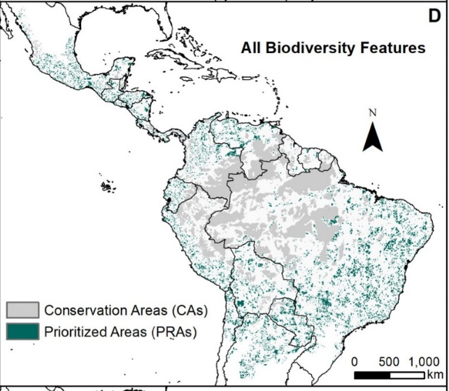
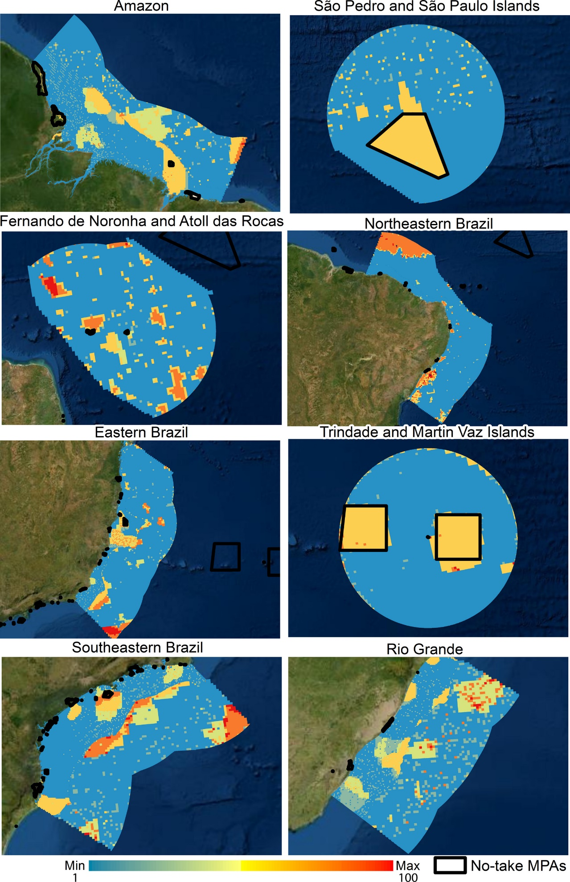
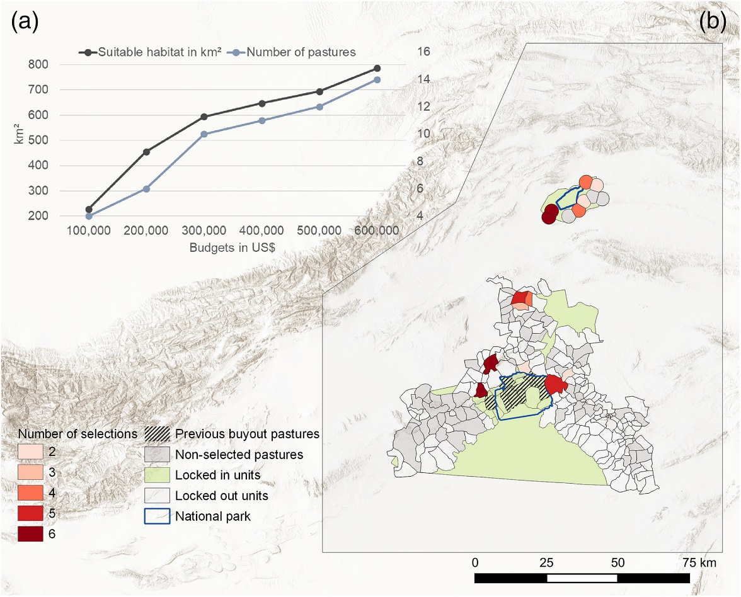


Accounting for existing conservation areas
Protected areas +
Indigenous Lands
No-take marine reserves
Areas with existing habitat + pastures where grazing rights have already been bought
Burbano-Girón et al. (2022)
DOI:10.1016/j.biocon.2021.109421
Magris et al. (2020)
DOI:10.1111/ddi.13183
Daberger et al. (2022)
10.1111/csp2.12832

Slide 34
Accounting for efficiency
Min $:
+9
+2
+5
+1
+5
+8
+3
+6
+8
+1
≥ 1
+1
+1
≥ 1
+1
+1
≥ 1
+1
≥ 1
+1
+1
+1
+1
+1
+1
≥ 1
Upper
1
1
1
1
1
1
1
1
1
Lower
0
1
0
0
0
0
1
0
0
V. type
B
B
B
B
B
B
B
B
B
1
2
3
4
5
6
7
8
9

Slide 35
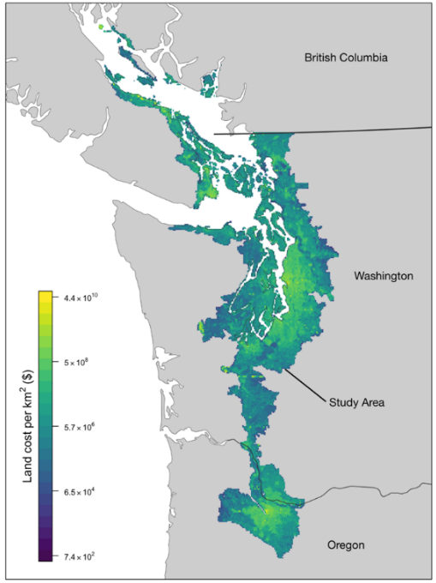
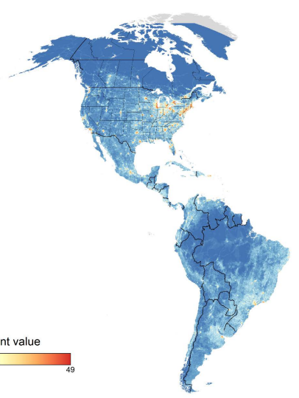
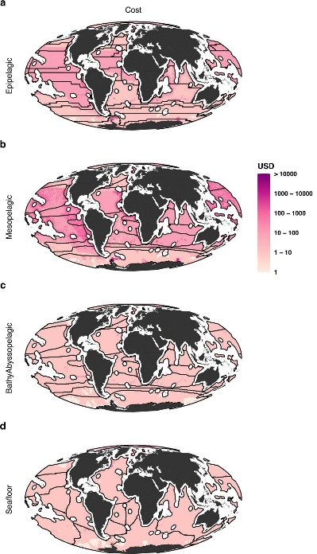
Accounting for efficiency
Land value assessments
Human pressure
Opportunity cost to commercial fisheries
Rodewald et al. (2019)
DOI:10.1038/s41598-019-52241-2
Schuster et al. (2019)
DOI:10.1038/s41467-019-09723-8
Brito-Morales et al. (2022)
DOI:10.1038/s41558-022-01323-7

Slide 36
Accounting for adequacy, comprehensiveness, and representativeness
Min $:
+9
+2
+5
+1
+5
+8
+3
+6
+8
+10
≥ 10
+2
+5
≥ 7
+3
+7
≥ 3
+1
≥ 1
+9
+8
+9
+8
+4
+3
≥ 12
Upper
1
1
1
1
1
1
1
1
1
Lower
0
1
0
0
0
0
1
0
0
V. type
B
B
B
B
B
B
B
B
B
1
2
3
4
5
6
7
8
9

Slide 37
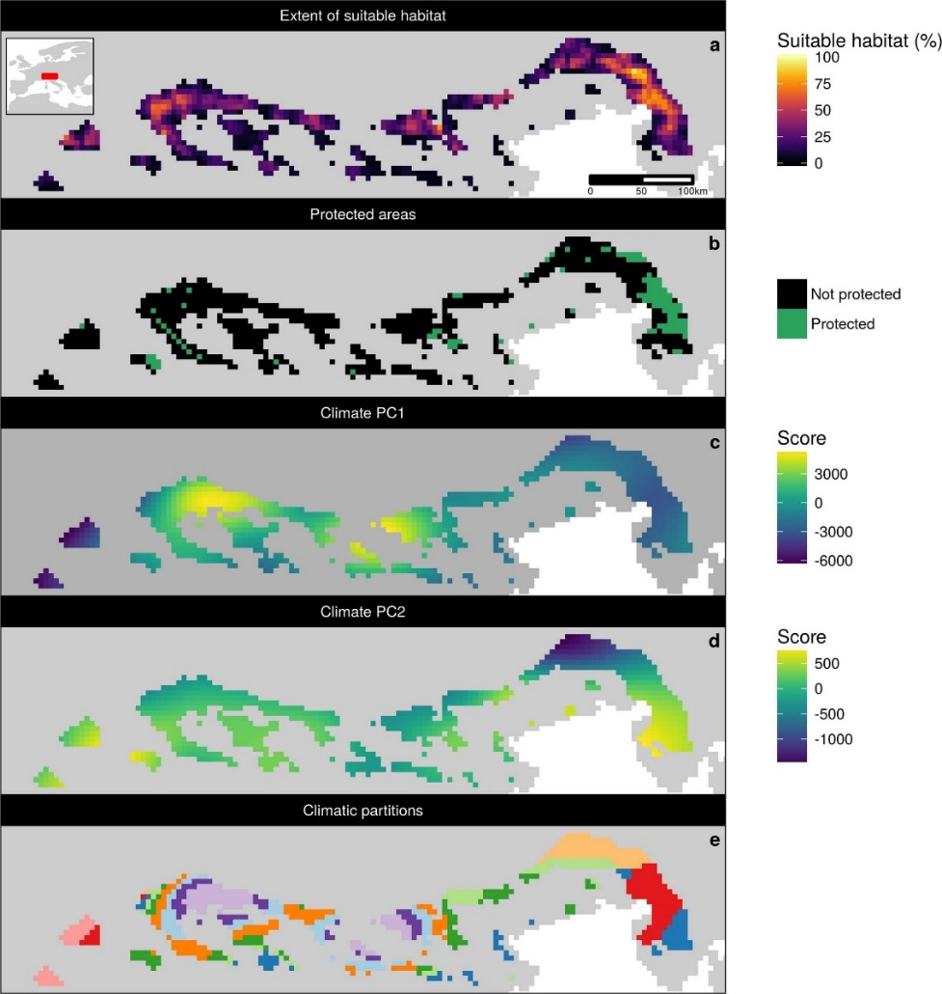
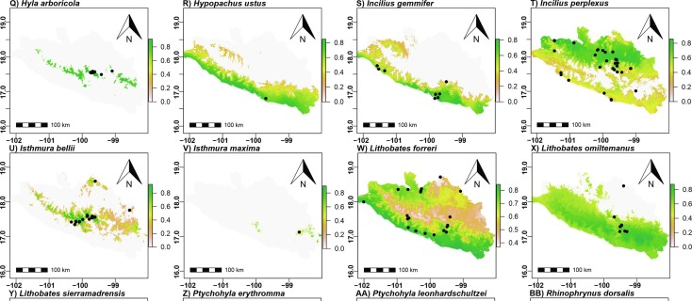

Accounting for adequacy
Get good data…
and set meaningful targets!
Policy
Expert thresholds
Statistical analysis
Southee et al. (2021) DOI: 10.1139/facets-2020-0015
Proctor et al. (2022) DOI: 10.1111/csp2.12771
High resolution estimates of habitat suitability
Hanson et al. (2022) DOI:10.1038/s41586-020-2138-7
Hanson et al. (2022) DOI: 10.1038/s41586-020-2138-7
Jung et al. 2021 DOI :10.1038/s41559-021-01528-7
Taylor et al. (2017) DOI: 10.1371/journal.pone.0169629
Species distribution models
González-Fernández (2022) DOI:10.1016/j.jnc.2022.126235

Slide 38
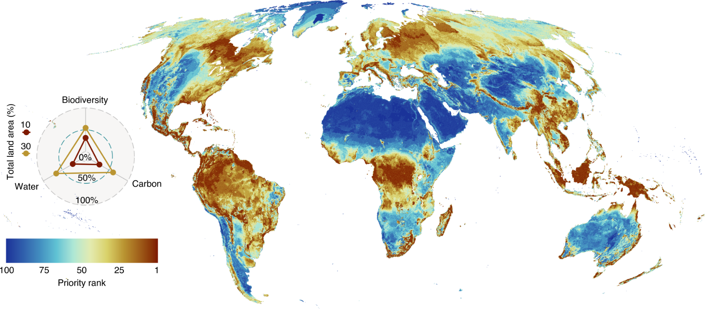
Accounting for comprehensiveness
Amphibians, mammals, birds, reptiles, plants, water provisioning, carbon sequestration
Jung et al. 2021 DOI:10.1038/s41559-021-01528-7

Slide 39
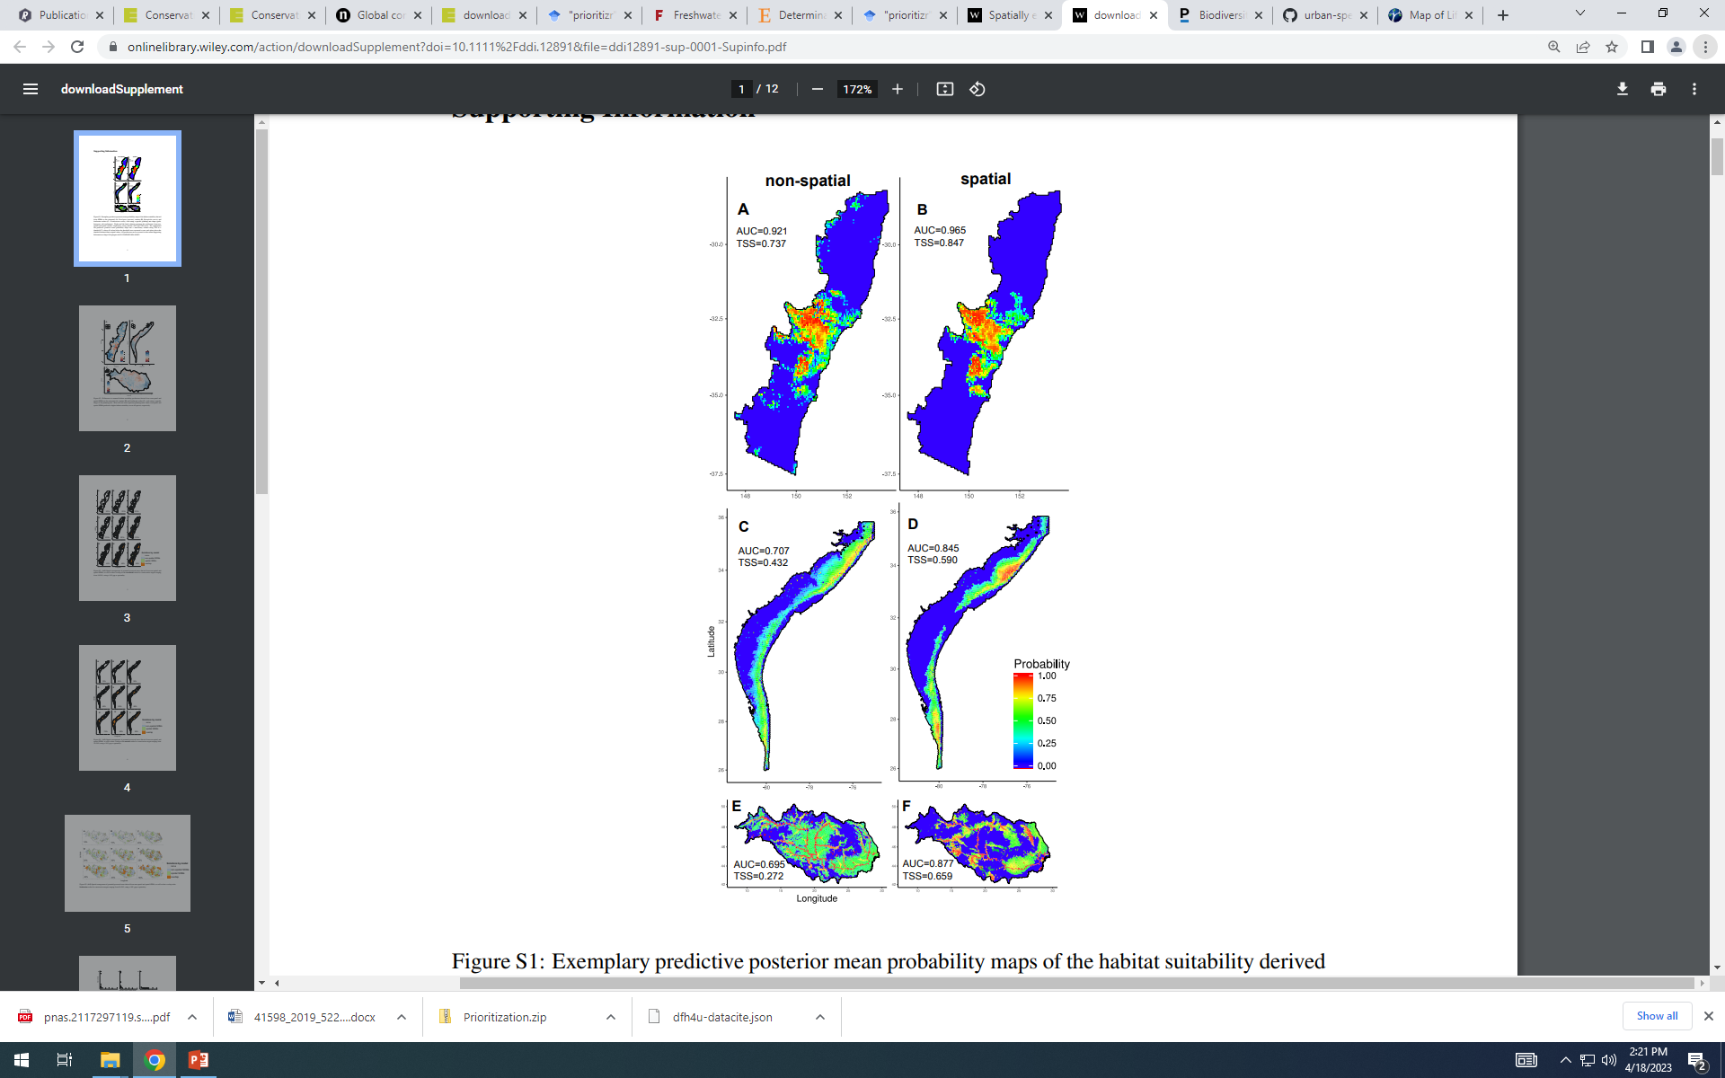
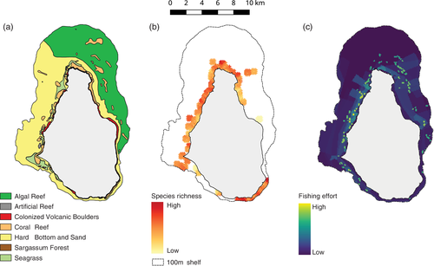
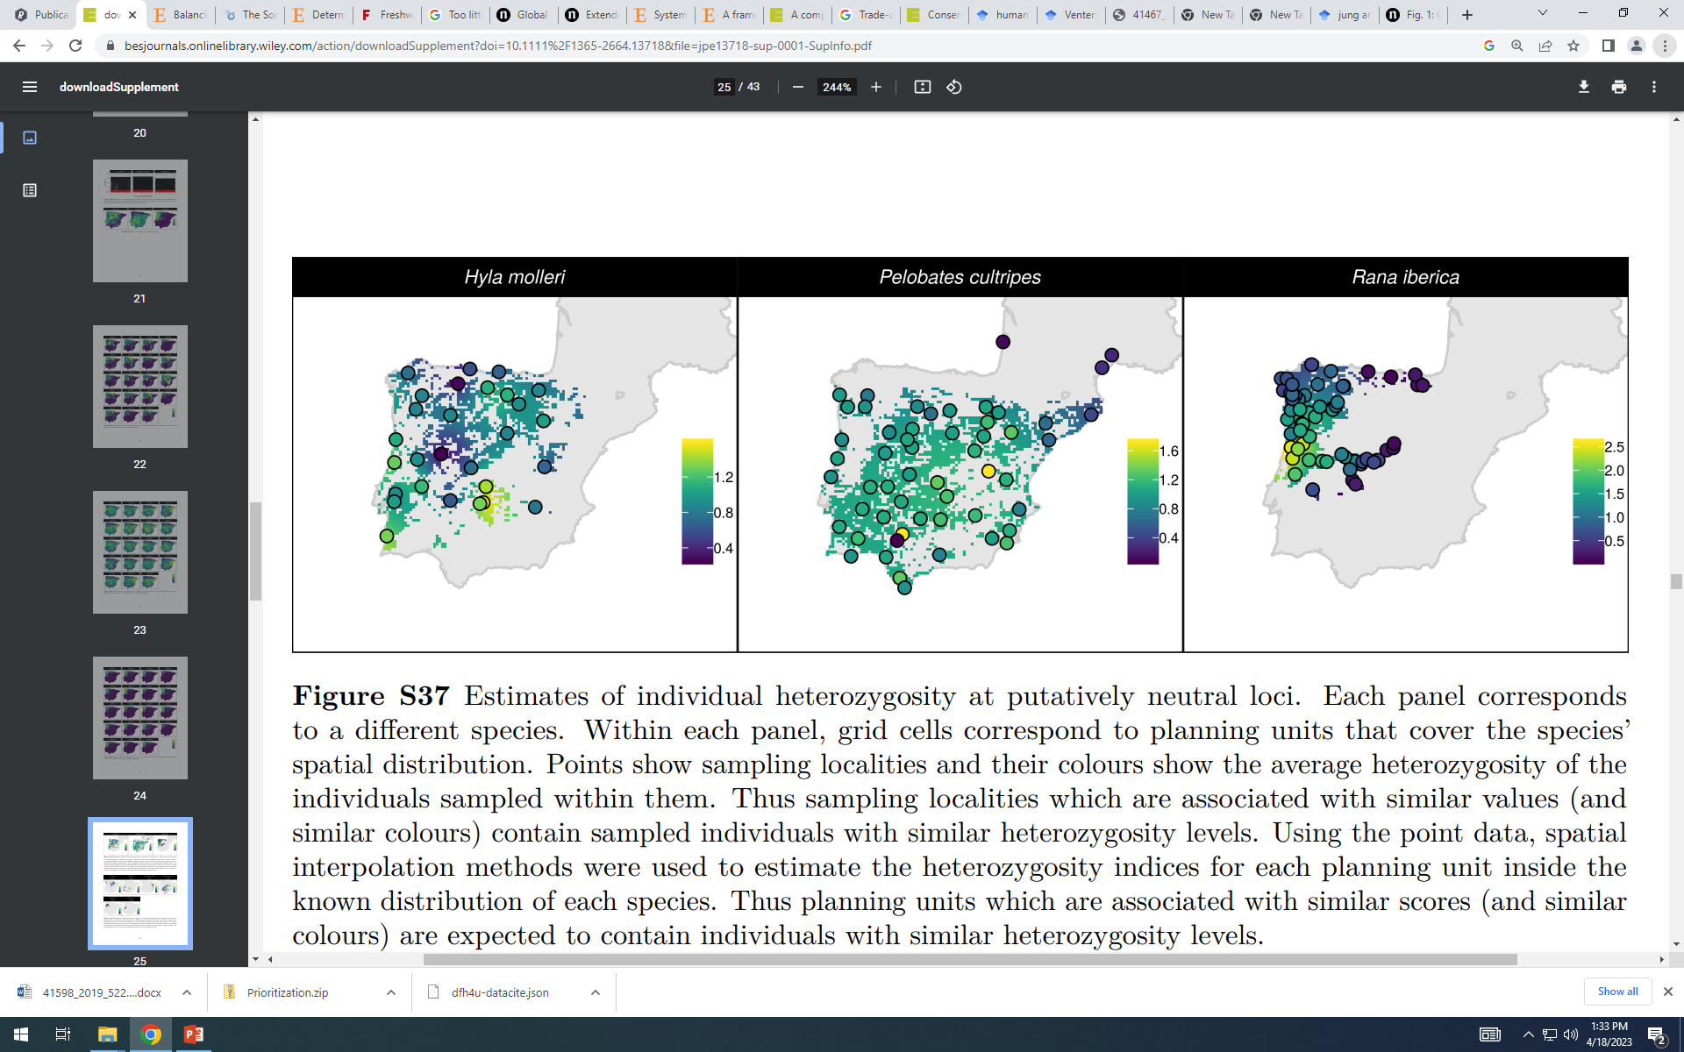
Accounting for representativeness
Species
Ecosystems
Genes
Hanson et al. (2022)
DOI: 10.1111/1365-2664.13718
Flower et al. (2010)
DOI: 10.1111/csp2.158
Domisch et al. (2019)
DOI: 10.1111/ddi.12891

Slide 40
Accounting for connectivity
Min $:
+9
+2
+5
+1
+5
+8
+3
+6
+8
+10
≥ 10
+2
+5
≥ 7
+3
+7
≥ 3
+1
≥ 1
+9
+8
+9
+8
+4
+3
≥ 12
Upper
1
1
1
0
1
1
1
1
0
Lower
0
1
0
0
0
0
1
0
0
V. type
B
B
B
B
B
B
B
B
B
1
2
3
4
5
6
7
8
9

Slide 41
What if connectivity = 1/distance?
Min $:
+9
+2
-3*1/5
Let’s just consider islands 1 and 2
-1
+1
≤ 0
+1
-1
1
2
≤ 0
-1
-1
+1
≥ -1
5 km
Upper
1
1
1
Lower
0
1
0
V. type
B
B
B
1
2
1&2
Scaling factor: 3 connectivity units = 1 cost unit
Beyer et al. (2016)
DOI:10.1016/j.ecolmodel.2016.02.005

Slide 42
What if connectivity = 1/distance?
Min $:
+9
+2
-3*1/5
Let’s just consider islands 1 and 2
(1)
-1
+1
≤ 0
1
(2)
+1
-1
≤ 0
1
2
-1
-1
+1
≥ -1
5 km
Upper
1
1
1
Lower
0
1
0
V. type
B
B
B
1
2
1&2
So, +1 variable and +2 constraints per pair of planning units.. increases problem size a lot!
E.g., 1k planning =
~500k extra constraints

Slide 43
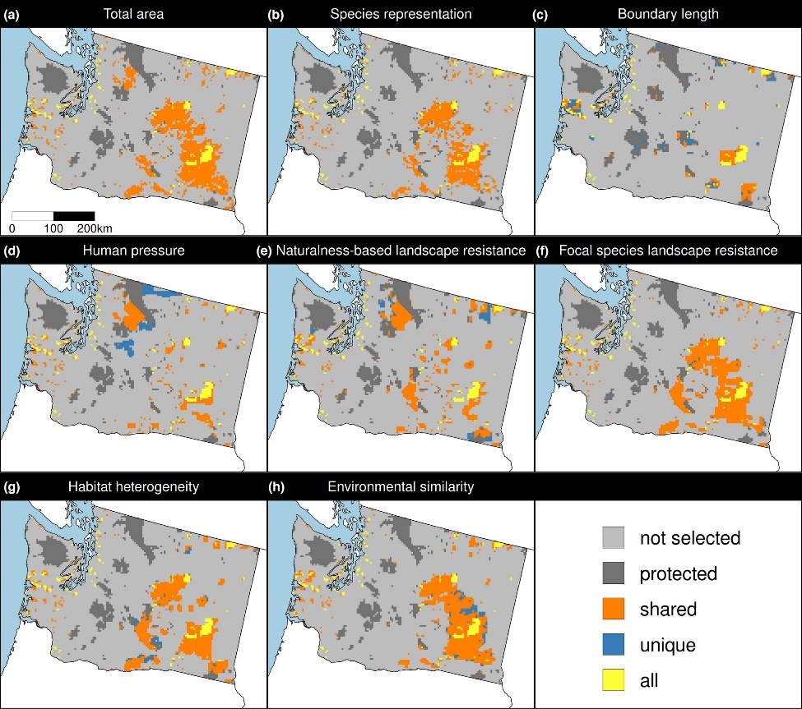
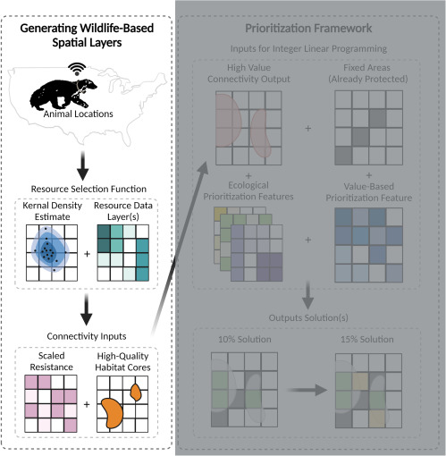
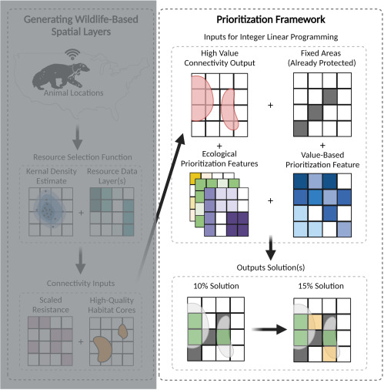
Accounting for connectivity
Carroll (2021)
DOI:10.1016/j.xpro.2021.100882
Hanson et al. (2022) DOI:10.1111/1365-2664.14251

Slide 44
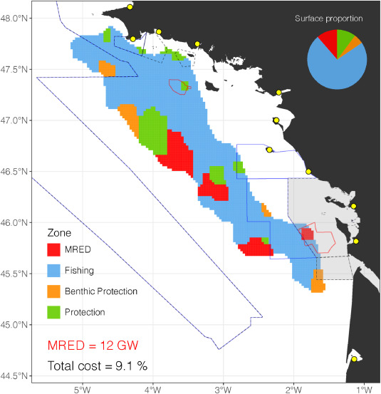
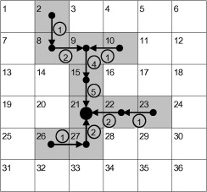
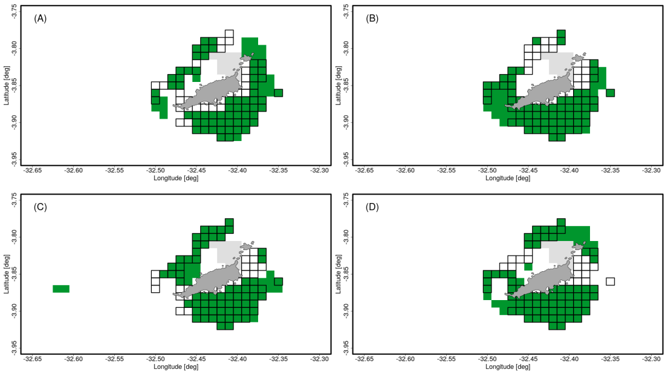
Other stuff too!
Solution portfolios
Spatially contiguity
Brunel et al. (2022)
DOI: 10.1007/s10666-022-09862-1
Wang and Önal (2013)
DOI: 10.1016/j.chnaes.2013.07.004
Multiple management zones
Boussarie et al. (2023)
DOI: 10.1016/j.jenvman.2023.117857

Slide 45

prioritizr
Human readable code
Design your problem
Solve it fast!

Slide 46
Package workflow
Biodiversity data
Input to solver
Land use data
Economic data
Solve problem
Problem formulation
Maps
Statistics

Slide 47

Package workflow
Biodiversity data
Input to solver
Land use data
Economic data
Solve problem
Problem formulation
Maps
Statistics

Slide 48
Package workflow
Biodiversity data
Input to solver
Land use data
Economic data
Solve problem
Problem formulation
Maps
Statistics

Slide 49
Human-readable code
Mental model
Code
problem <-
data +
objective +
constraints +
penalties +
decision type +
solver
solution <- solve(problem)
p <-
problem(areas, feats) %>%
add_min_set_objective() %>%
add_relative_targets(0.1) %>%
add_boundary_penalties(5) %>%
add_binary_decisions() %>%
add_rsymphony_solver()
solution <- solve(p)

Slide 50
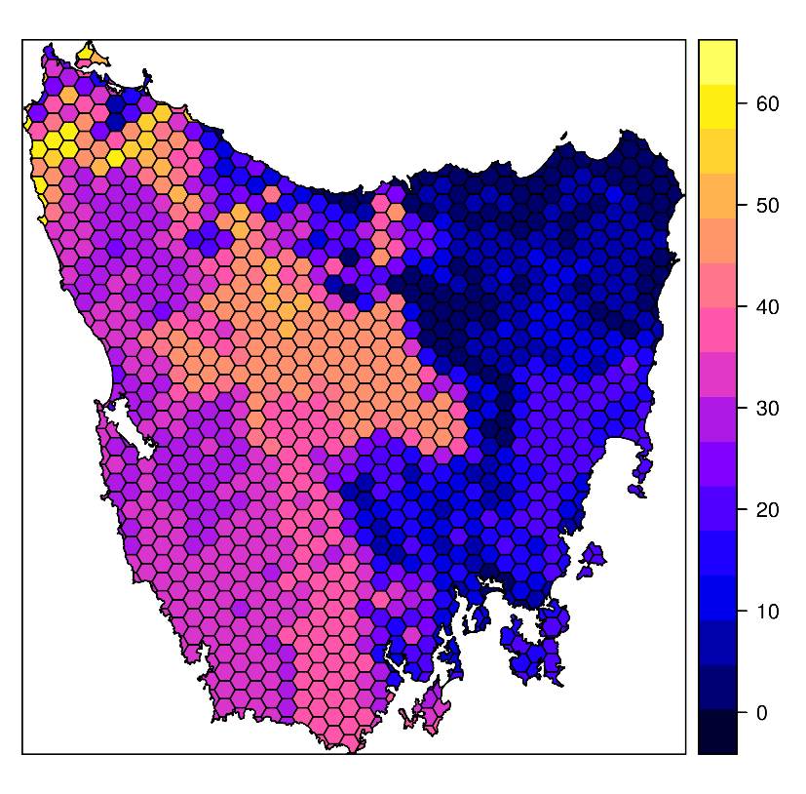
Design your problem
Study area: Tasmania, Australia
Planning units: 1130 hexagons
Features: 63 vegetation types

Slide 51
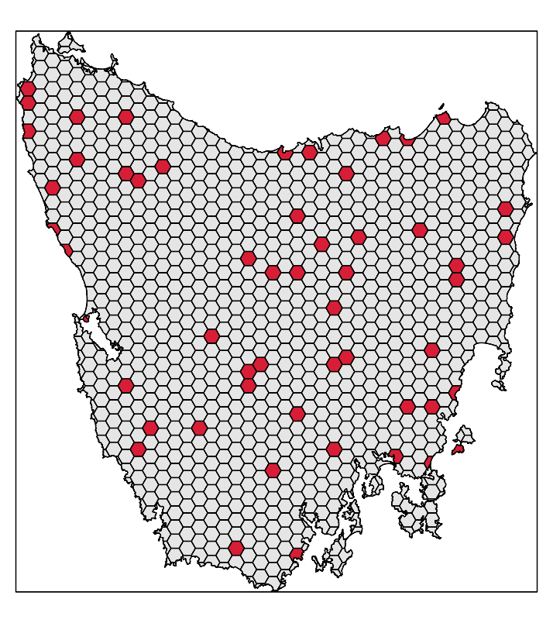
Design your problem
problem(tas_pu, tas_features,
"cost") %>%
add_min_set_objective() %>%
add_relative_targets(0.1) %>% add_binary_decisions() %>%
add_gurobi_solver(gap = 0) %>% solve()

Slide 52
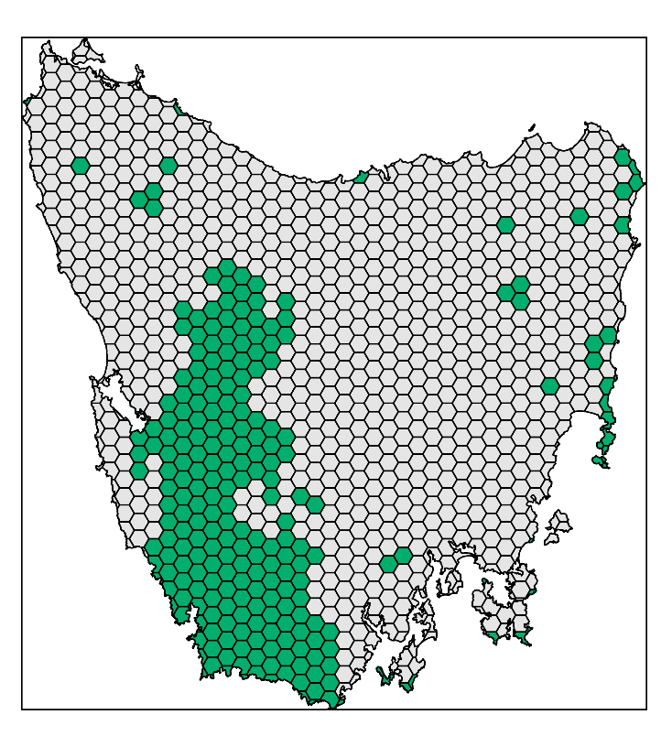
Design your problem
problem(tas_pu, tas_features,
"cost") %>%
add_min_set_objective() %>%
add_relative_targets(0.1) %>% add_locked_in_constraints("in") %>%
add_binary_decisions() %>%
add_gurobi_solver(gap = 0) %>% solve()

Slide 53
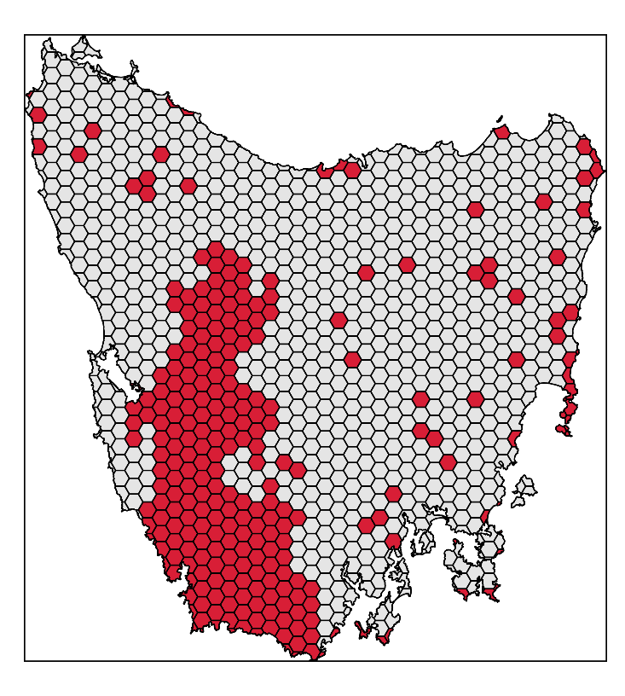
Design your problem
problem(tas_pu, tas_features,
"cost") %>%
add_min_set_objective() %>%
add_relative_targets(0.1) %>% add_locked_in_constraints("in") %>%
add_binary_decisions() %>%
add_gurobi_solver(gap = 0) %>% solve()

Slide 54
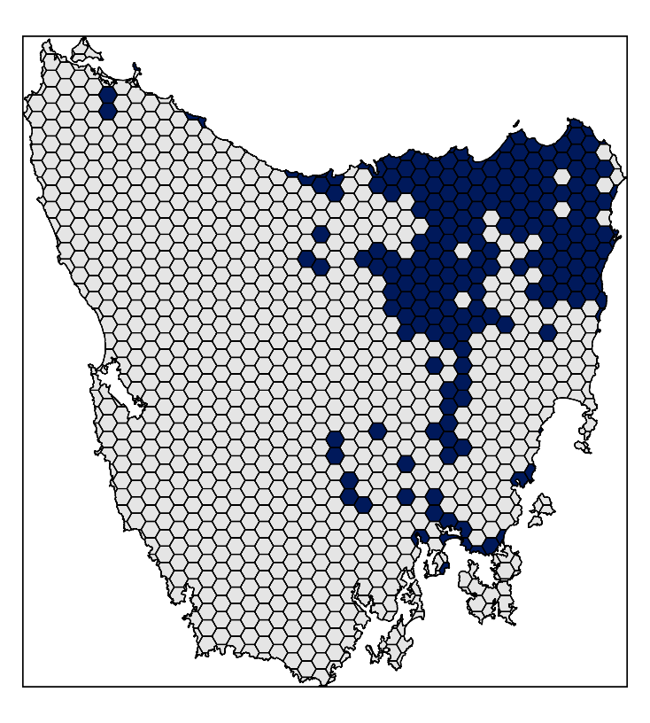
Design your problem
problem(tas_pu, tas_features,
"cost") %>%
add_min_set_objective() %>%
add_relative_targets(0.1) %>% add_locked_in_constraints("in") %>%
add_locked_out_constraints("out") %>%
add_binary_decisions() %>%
add_gurobi_solver(gap = 0) %>% solve()

Slide 55
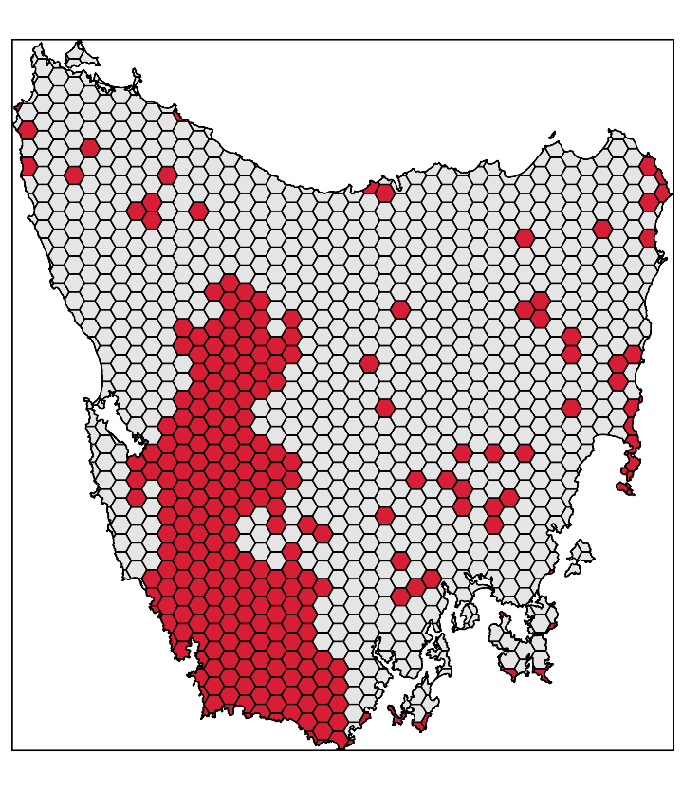
Design your problem
problem(tas_pu, tas_features,
"cost") %>%
add_min_set_objective() %>%
add_relative_targets(0.1) %>% add_locked_in_constraints("in") %>%
add_locked_out_constraints("out") %>%
add_binary_decisions() %>%
add_gurobi_solver(gap = 0) %>% solve()

Slide 56
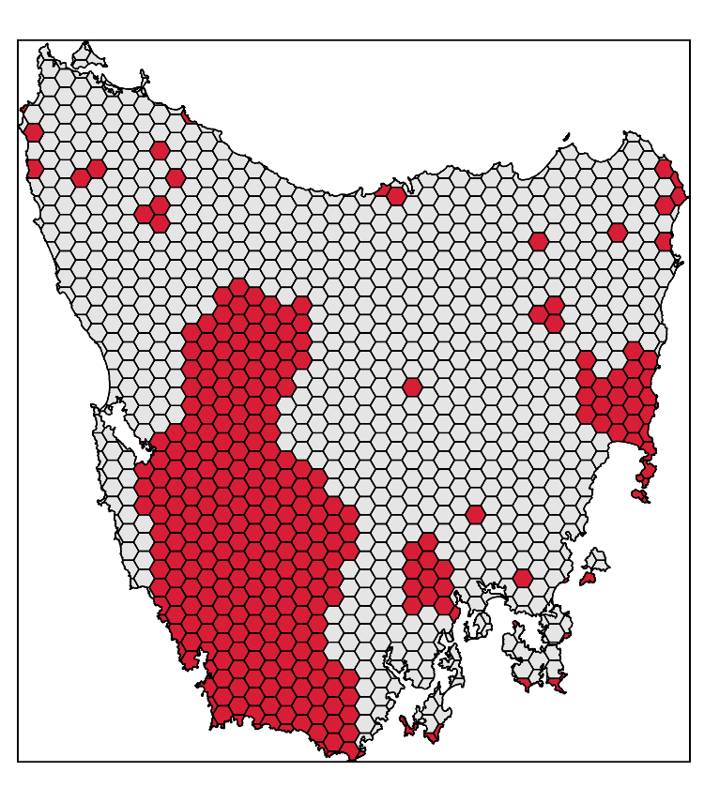
Design your problem
problem(tas_pu, tas_features,
"cost") %>%
add_min_set_objective() %>%
add_relative_targets(0.1) %>% add_locked_in_constraints("in") %>%
add_locked_out_constraints("out") %>%
add_boundary_penalties(0.01, 0.5) %>%
add_binary_decisions() %>%
add_gurobi_solver(gap = 0) %>% solve()

Slide 57
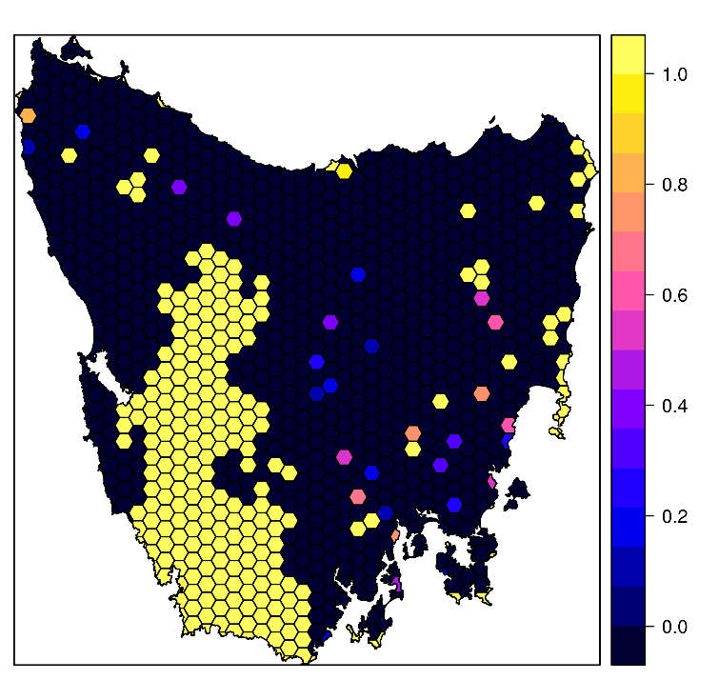
Design your problem
problem(tas_pu, tas_features,
"cost") %>%
add_min_set_objective() %>%
add_relative_targets(0.1) %>% add_locked_in_constraints("in") %>%
add_locked_out_constraints("out") %>%
add_proportion_decisions() %>%
add_gurobi_solver(gap = 0) %>% solve()

Slide 58
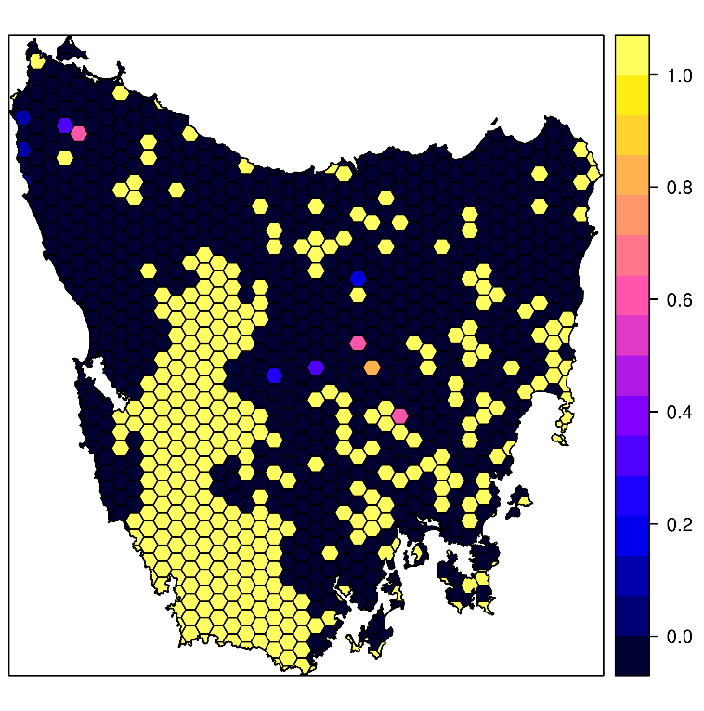
Design your problem
problem(tas_pu, tas_features,
"cost") %>%
add_max_features_objective(budget)%>%
add_relative_targets(0.1) %>% add_locked_in_constraints("in") %>%
add_locked_out_constraints("out") %>%
add_proportion_decisions() %>%
add_gurobi_solver(gap = 0) %>% solve()

Slide 59
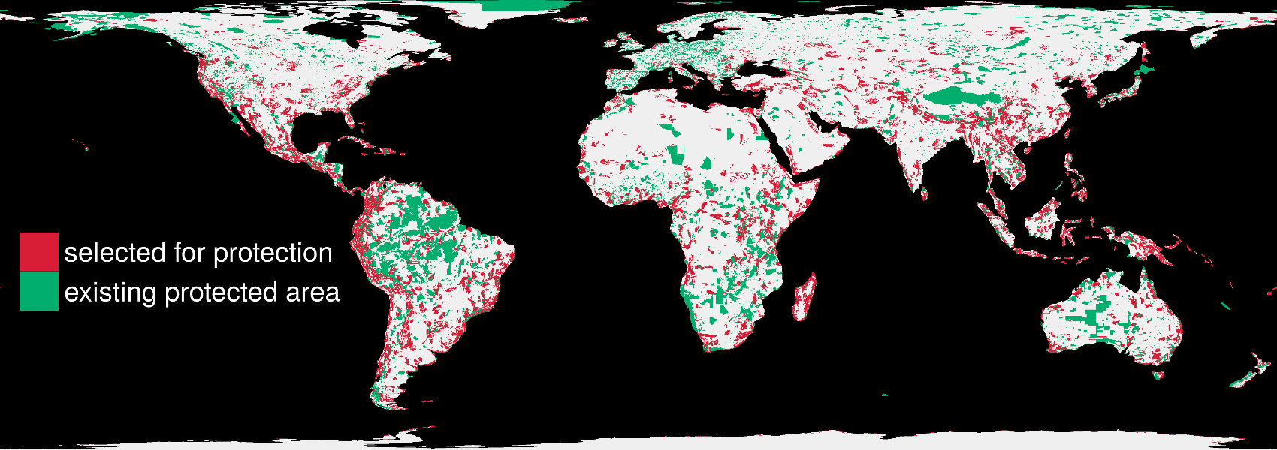
Solve it fast!
1.5 million planning units & 22,644 species: 76 minutes

Slide 60





Guaranteed quality
Heuristic
algorithms
Meta-heuristic
algorithms
Exact algorithms
Estimate of best solution
Quality
Different
solutions
Different
solutions
Different
solutions

Slide 61
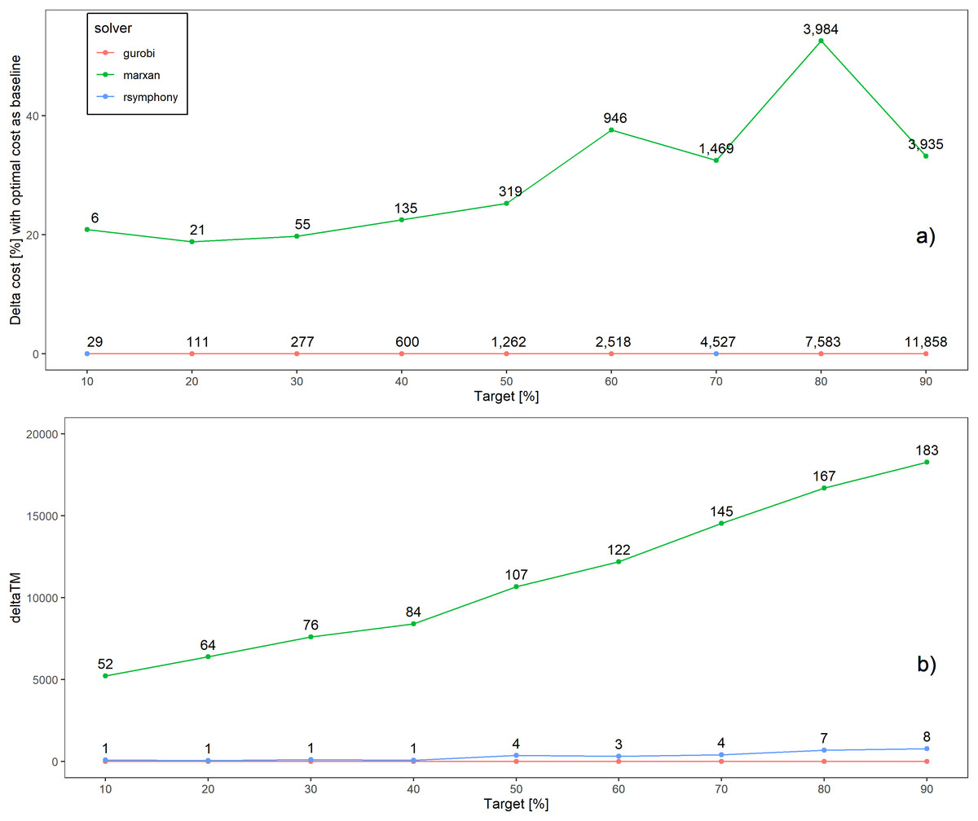
Solve efficiently + fast
Schuster et al. (2020) PeerJ, DOI:10.7717/peerj.9258

Slide 62
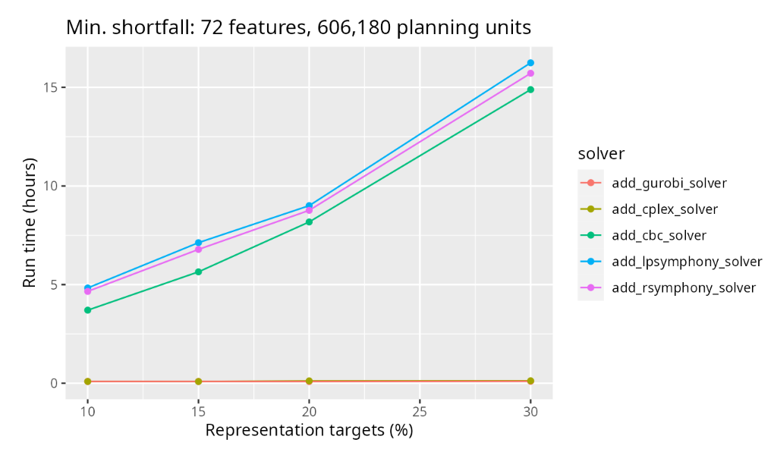
The catch: for complex problems, open-source solvers are a lot slower than Gurobi and IBM CPLEX (https://prioritizr.net/articles/solver_benchmarks.html)

Slide 63
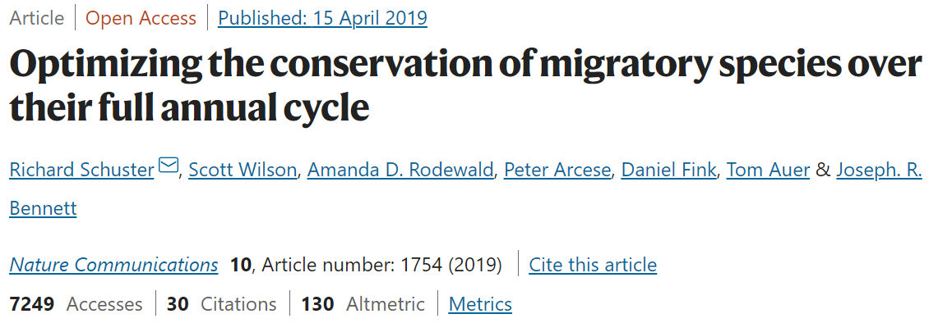
Example

Slide 64
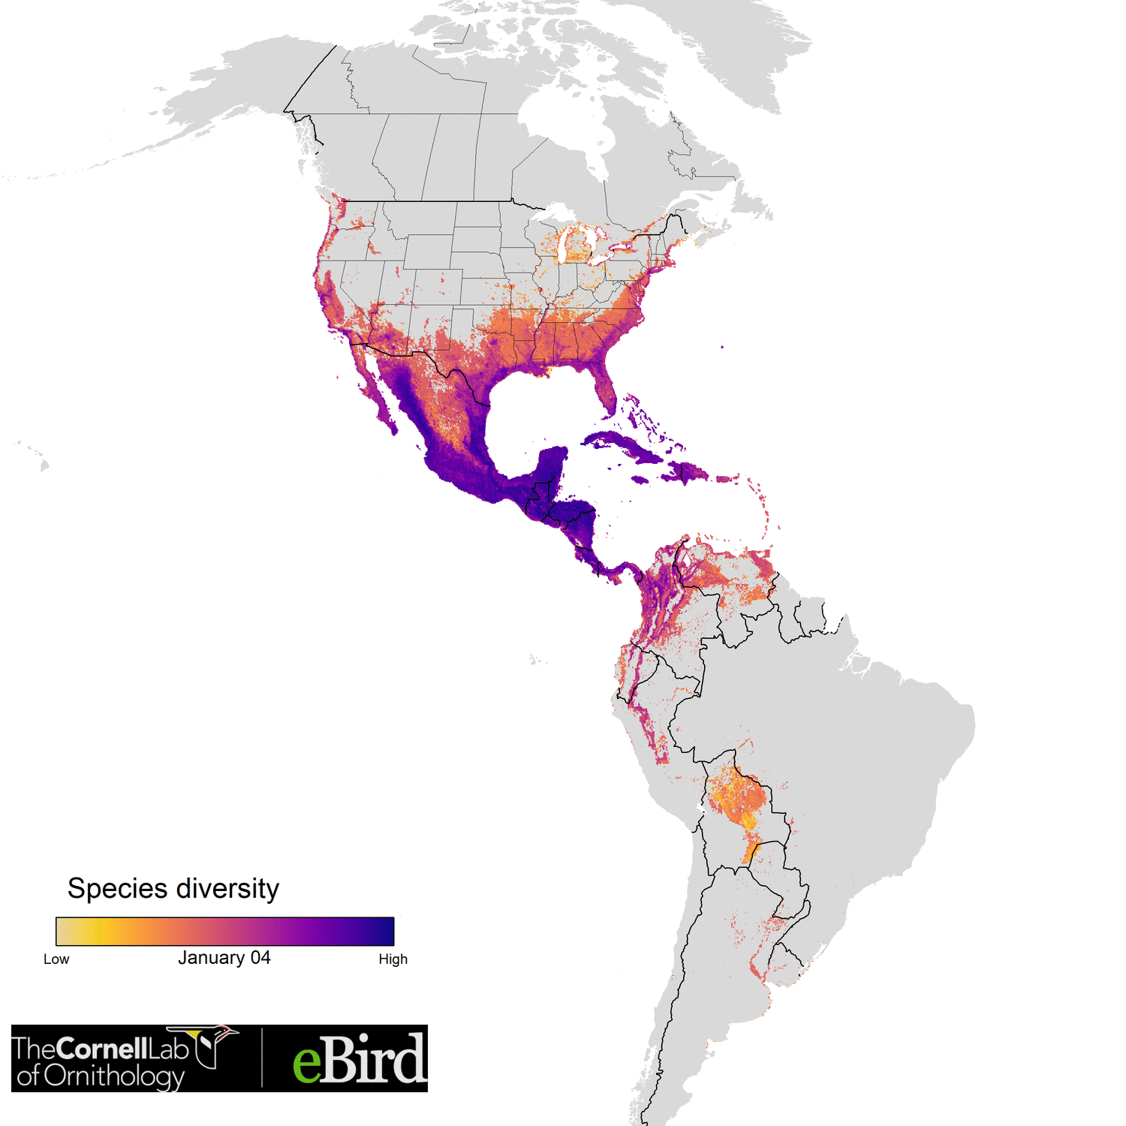


Optimizing the conservation of migratory species over their full annual cycle
117 species
73 million km²
1.7 million unique locations
14 million checklists
≤ 30,420 features
1.05 million planning units
Analysis powered by:
Schuster et al. (2019) Nature Communications

Slide 65
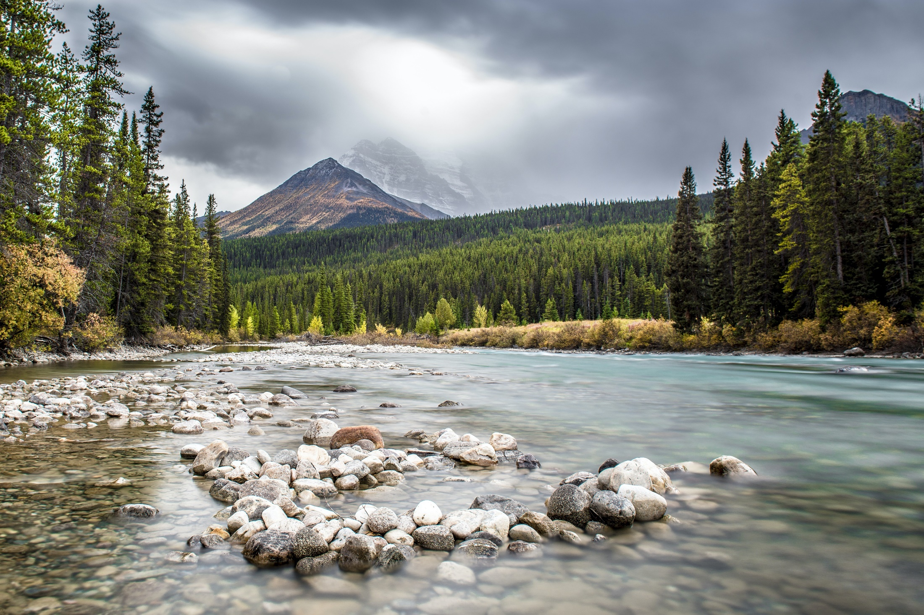

Conservation Decision Making Framework

Slide 66
Resilient Landscapes
Biodiversity
People
Connectivity
Climate
Invasives
Land Use
Notes:
What’s there to do for us? We can’t or don’t properly account for connectivity in decision making. Just introducing climate.
We are working on resilient landscape and can evaluate our work against them.
Biodiversity – how many species + where are they
Minerals – where are they + overlap with biodiversity and people
Connectivity

Slide 67
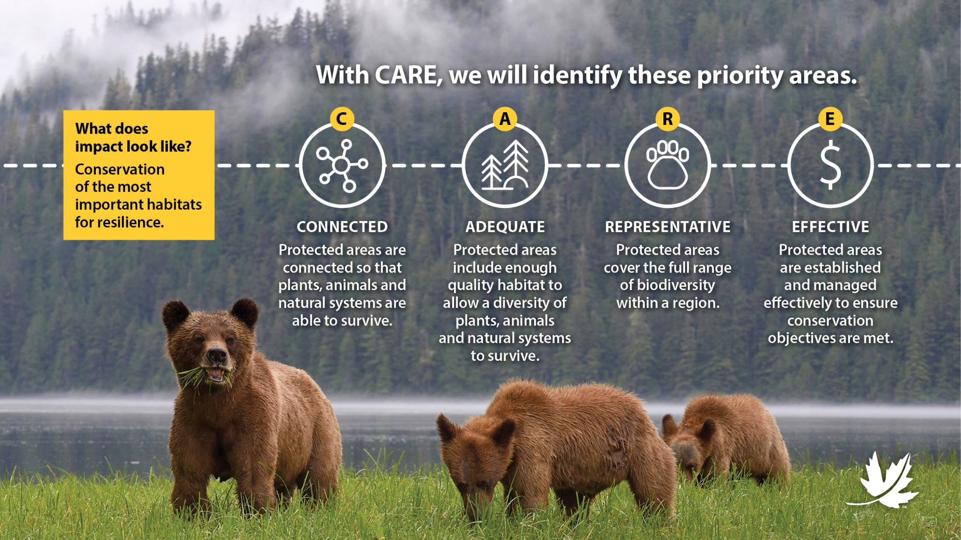

Slide 68
Where to work?
Resilient landscapes must include:
the full range of Biodiveristy,
in a sufficiently large area,
areas connected to each other
protected areas that are effectively managed
Canada is a big country with a lot of species. Where should we work?

Slide 69
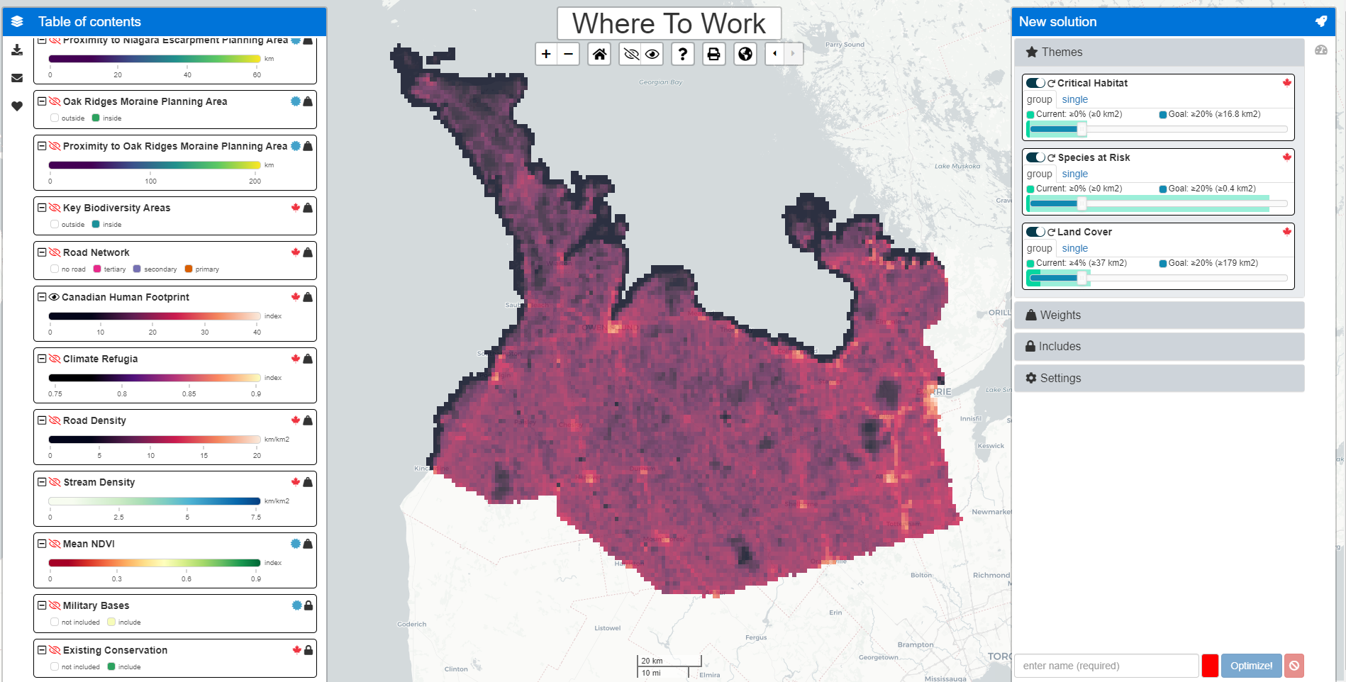
Demo
CARE at the Landscape level (Where To Work)
Scalable (Property to Country scale)
Seamless (1km grid across Canada)
Scientific (best available)

Slide 70
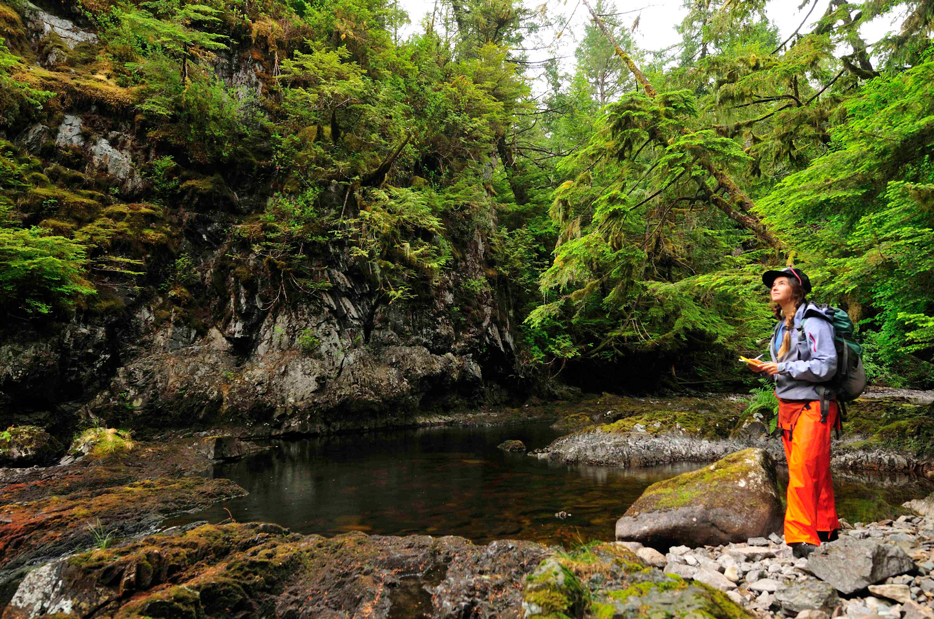
Questions?
jeffrey.hanson@uqconnect.edu.au
richard.schuster@natureconservancy.ca

